Slide 1
Transaction Management
A transaction is a logical unit of work that should be either entirely completed or aborted.
No intermediate states are acceptable.
A transaction consists of a single database operation or a sequence of them.
Consistent State
Consistent State
transaction

Slide 2
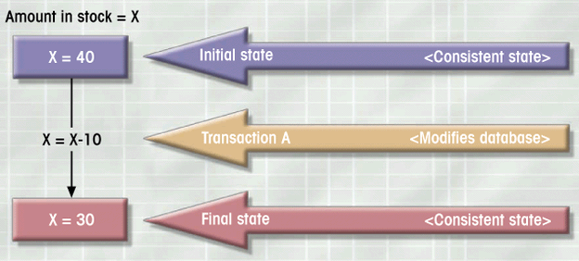
What is a Transaction?
Logical unit of work
Must be either entirely completed or aborted
No intermediate states are acceptable
Notes:
4

Slide 3
Example Transaction
Examine current account balance
Consistent state after transaction
No changes made to Database
SELECT ACC_NUM, ACC_BALANCE
FROM CHECKACC
WHERE ACC_NUM = ‘0908110638’;
Notes:
6

Slide 4
Example Transaction
Register credit sale of 100 units of product X to customer Y for $500
Consistent state only if both transactions are fully completed
DBMS doesn’t guarantee transaction represents real-world event
UPDATE PRODUCT
SET PROD_QOH = PROD_QOH - 100
WHERE PROD_CODE = ‘X’;
UPDATE ACCT_RECEIVABLE
SET ACCT_BALANCE = ACCT_BALANCE + 500
WHERE ACCT_NUM = ‘Y’;
Notes:
6

Slide 5
ASID: Transaction Properties
Atomicity
  All transaction operations must be completed
  Incomplete transactions aborted
Durability
  Permanence of consistent database state
Serializability
  Conducts transactions in serial order
  Important in multi-user and distributed databases
Isolation
  Transaction data cannot be reused until its execution complete
Notes:
9

Slide 6
Properties of Transactions
ACID: properties of a transaction are:
Atomicity ‘All or nothing’ property.
Consistency Must transform database from one consistent state to another.
Isolation Partial effects of incomplete transactions should not be visible to other transactions.
Durability Effects of a committed transaction are permanent and must not be lost because of later failure.

Slide 7
Transaction Management with SQL
Transaction support
  COMMIT
  ROLLBACK
User initiated transaction sequence must continue until:
  COMMIT statement is reached
  ROLLBACK statement is reached
  End of a program reached
  Program reaches abnormal termination
Notes:
10

Slide 8
Transaction Concurrency
Concurrency control is necessary when more than one transactions want to access the same data at the same time in a multiuser database environment.
Three main concurrency problems are: lost updates, uncommitted dependency, and inconsistent retrievals.
Serializability mechanism with locking protocol solves the problems.

Slide 9
Concurrency Control
Coordinates simultaneous transaction execution in multiprocessing database
  Ensure serializability of transactions in multiuser database environment
  Potential problems in multiuser environments
    Lost updates
    Uncommitted data
    Inconsistent retrievals
Notes:
14

Slide 10
The Lost Update problem
Ta
time
Tb
Fetch R
T1
T2
Fetch R
Update R (lost at T4 !)
T3
T4
Update R
Ta’s update at T4 is lost because Tb overwrites it without looking at the update
Leads to deadlock problem

Slide 11
The Uncommitted Dependency Problem
Ta
time
Tb
T1
T2
Update R
Fetch/Update R
T3
T4
(Rollback )
Ta sees an uncommitted update
Ta’s fetch becomes dependent on an uncommitted change of Tb !
Another lost update problem when updated by Ta !

Slide 12
The Inconsistent Retrieval Problem
Ta
time
Tb
Ta: sums account balances
Tb: transfers
Ta writes the result back into database (inconsistent !)
Fetch ACC1 (40) sum = 40
T1
Fetch ACC2 (50) sum = 90
T2
T3
Fetch ACC3 (30)
T4
Update ACC3 : 30->20
T1
Fetch ACC1 (40)
T2
Update ACC1 : 40->50
T3
(COMMIT)
Fetch ACC3 (20) sum = 110 ?
T4

Slide 13
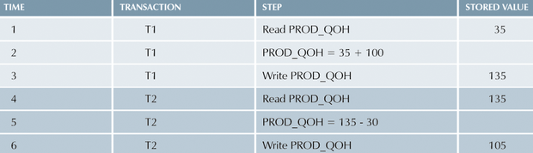
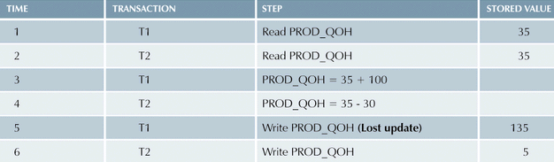
Lost Updates: Example

Slide 14
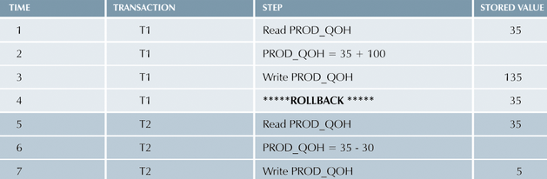
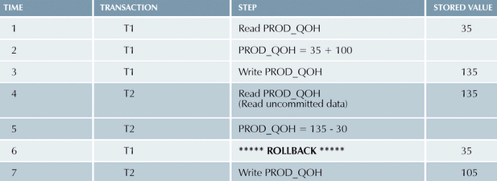
Uncommitted Data: Example

Slide 15
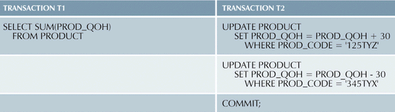
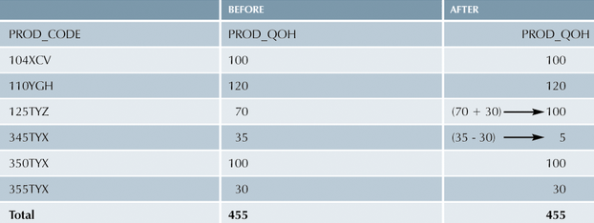
Inconsistent Retrievals: Example

Slide 16
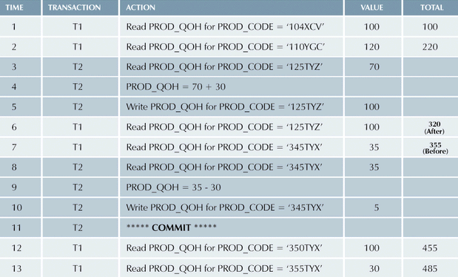
Inconsistent Retrievals (con’t.)

Slide 17
Lost Update Problem
Successfully completed update is overridden by another user.
T₁ withdrawing £10 from an account with bal_{x}, initially £100.
T₂ depositing £100 into same account.
Serially, final balance would be £190.

Slide 18
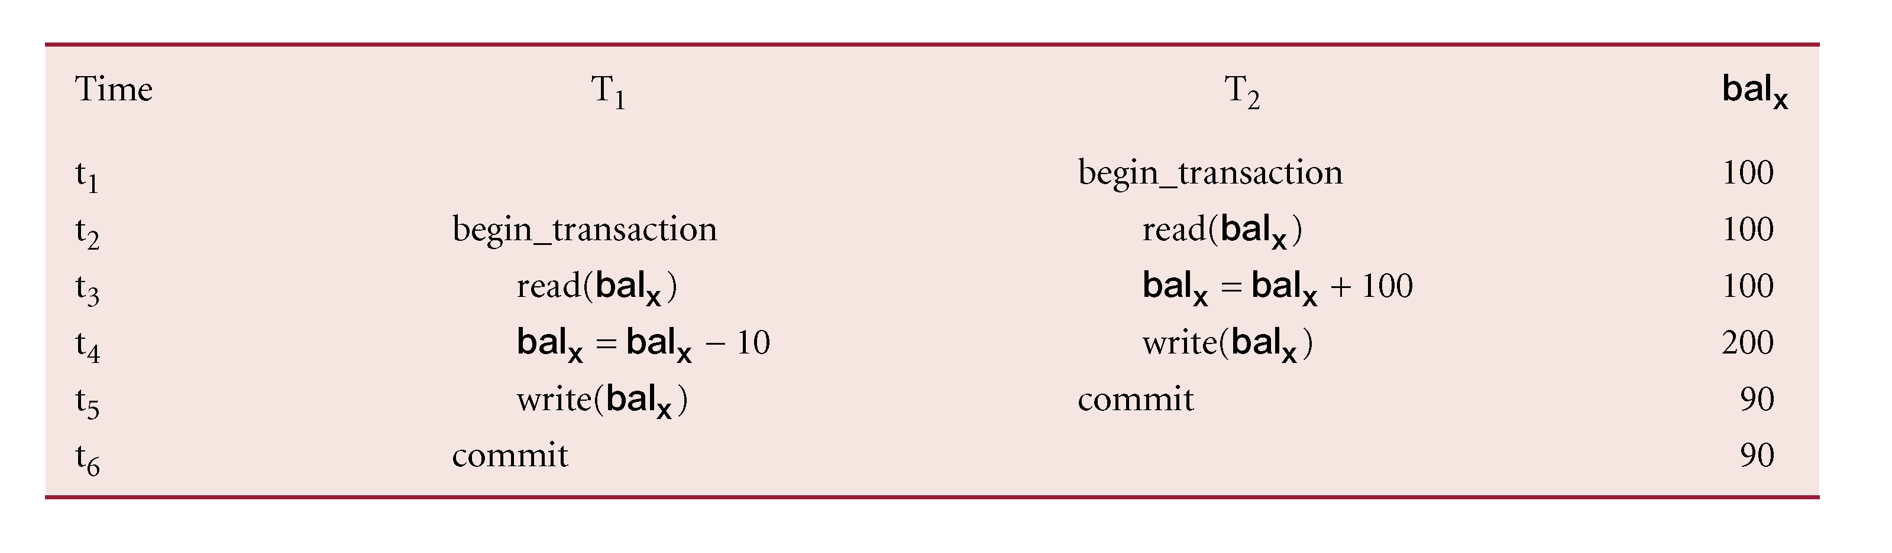
Lost Update Problem
Loss of T₂’s update avoided by preventing T₁ from reading bal_{x} until after update.

Slide 19
Uncommitted Dependency Problem
Occurs when one transaction can see intermediate results of another transaction before it has committed.
T₄ updates bal_{x} to £200 but it aborts, so bal_{x} should be back at original value of £100.
T₃ has read new value of bal_{x} (£200) and uses value as basis of £10 reduction, giving a new balance of £190, instead of £90.

Slide 20
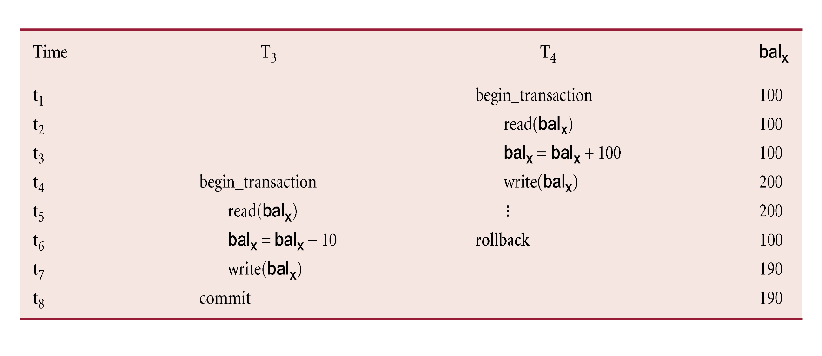
Uncommitted Dependency Problem
Problem avoided by preventing T₃ from reading bal_{x} until after T₄ commits or aborts.

Slide 21
Inconsistent Analysis Problem
Occurs when transaction reads several values but second transaction updates some of them during execution of first.
Sometimes referred to as dirty read or unrepeatable read.
T₆ is totaling balances of account x (£100), account y (£50), and account z (£25).
Meantime, T₅ has transferred £10 from bal_{x} to bal_{z}, so T₆ now has wrong result (£10 too high).

Slide 22
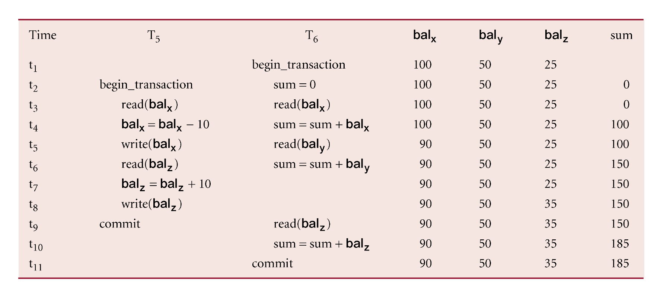
Inconsistent Analysis Problem
Problem avoided by preventing T₆ from reading bal_{x} and bal_{z} until after T₅ completed updates.

Slide 23
Serializability
Objective of a concurrency control protocol is to schedule transactions in such a way as to avoid any interference.
Could run transactions serially, but this limits degree of concurrency or parallelism in system.
Serializability identifies those executions of transactions guaranteed to ensure consistency.

Slide 24
Serializability
  Schedule
  Sequence of reads/writes by set of concurrent transactions.
  Serial Schedule
  Schedule where operations of each transaction are executed consecutively without any interleaved operations from other transactions.
No guarantee that results of all serial executions of a given set of transactions will be identical.

Slide 25
The Scheduler
Establishes order of concurrent transaction execution
Interleaves execution of database operations to ensure serializability
Bases actions on concurrency control algorithms
  Locking
  Time stamping
Ensures efficient use of computer’s CPU
Notes:
23

Slide 26
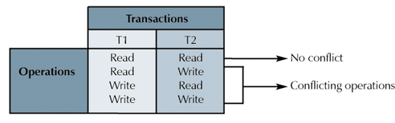
Read/Write Conflict Scenarios:
Conflicting Database Operations Matrix

Slide 27
Concurrency Control with Locking
Lock guarantees current transaction exclusive use of data item
Acquires lock prior to access
Lock released when transaction is completed
DBMS automatically initiates and enforces locking procedures
Managed by lock manager
Lock granularity indicates level of lock use
Notes:
25

Slide 28
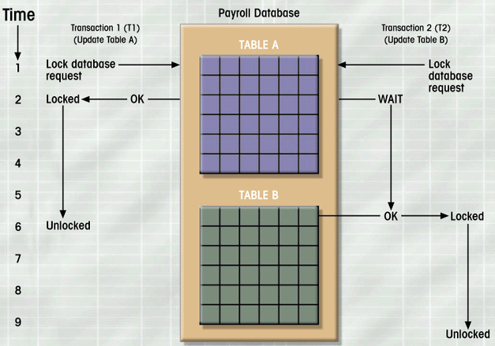
Database-Level Locking Sequence

Slide 29
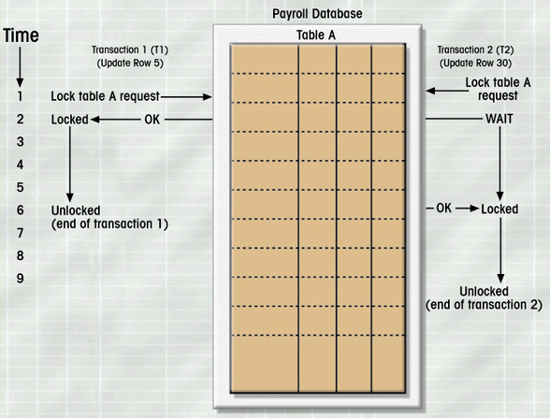
Table-Level Lock Example

Slide 30
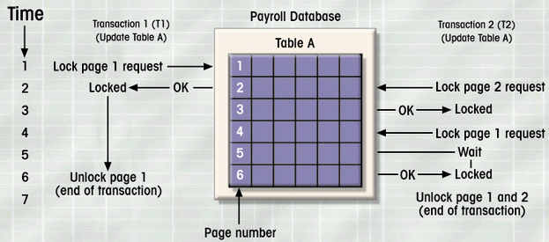
Page-Level Lock Example

Slide 31
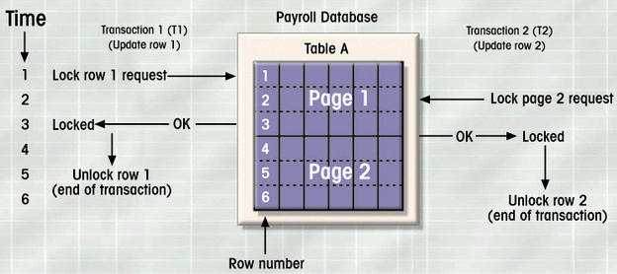
Row-Level Lock Example

Slide 32
Binary Locks
Two states
  Locked (1)
  Unlocked (0)
Locked objects unavailable to other objects
  Unlocked objects open to any transaction
  Transaction unlocks object when complete
Notes:
31

Slide 33
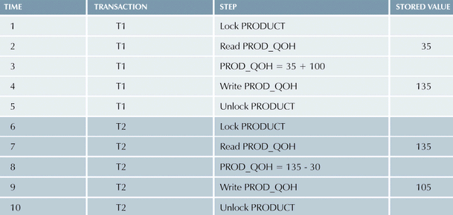
Example of Binary Lock Table
Notes:
31

Slide 34
Shared/Exclusive Locks
Shared
  Exists when concurrent transactions granted READ access
  Produces no conflict for read-only transactions
  Issued when transaction wants to read and exclusive lock not held on item
Exclusive
  Exists when access reserved for locking transaction
  Used when potential for conflict exists
  Issued when transaction wants to update unlocked data

Slide 35
Problems with Locking
  Transaction schedule may not be serializable
    Managed through two-phase locking
  Schedule may create deadlocks
    Managed by using deadlock detection and prevention techniques

Slide 36
Two-Phase Locking
Growing phase
Shrinking phase
Governing rules
  Two transactions cannot have conflicting locks
  No unlock operation can precede a lock operation in the same transaction
  No data are affected until all locks are obtained

Slide 37
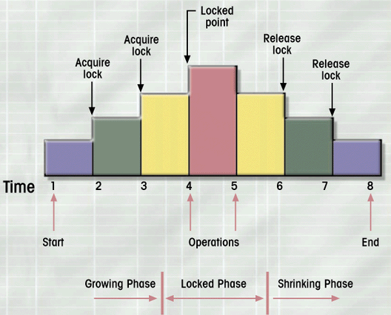
Two-Phase Locking Protocol

Slide 38
Deadlocks
Two (or more) transactions are in a wait state simultaneously, each waiting for one of the others to release a lock before proceed.
Called deadly embrace
Control techniques
  Deadlock prevention
  Deadlock detection
  Deadlock avoidance

Slide 39
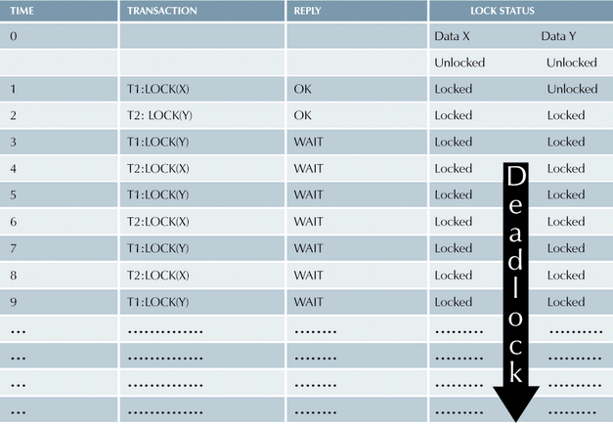
How Deadlock Conditions Created

Slide 40
Concurrency Control with Time Stamping Methods
Assigns global unique time stamp to each transaction
Produces order for transaction submission
Properties
  Uniqueness
  Monotonicity
DBMS executes conflicting operations in time stamp order
Each value requires two additional time stamps fields
  Last time field read
  Last update
Notes:
42

Slide 41
Concurrency Control with Optimistic Methods
Assumes most database operations do not conflict
Transaction executed without restrictions until committed
Phases:
  Read Phase
  Validation Phase
  Write Phase
Notes:
43

